Slide 1
Chem 108
Lab
Week 17
Sit @ your original Lab Drawer Station: the one that you signed in for @ the beginning of the semester.
Pick up:
  your pink inventory sheet
  a padlock
  a tag for your combination lock if you don’t have the one that came with it @ the beginning of the semester

Slide 2
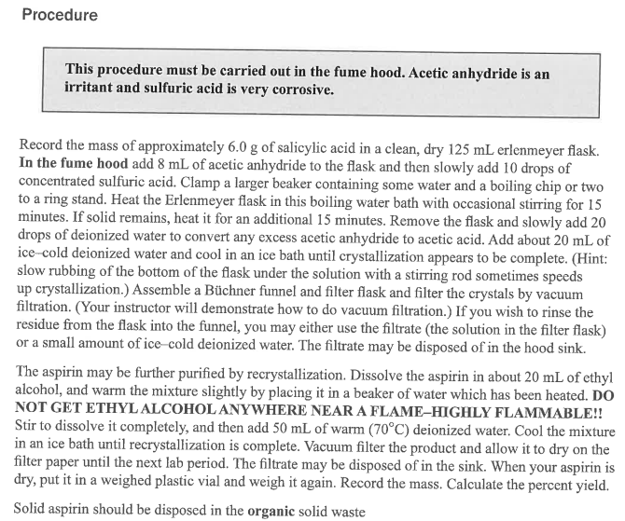
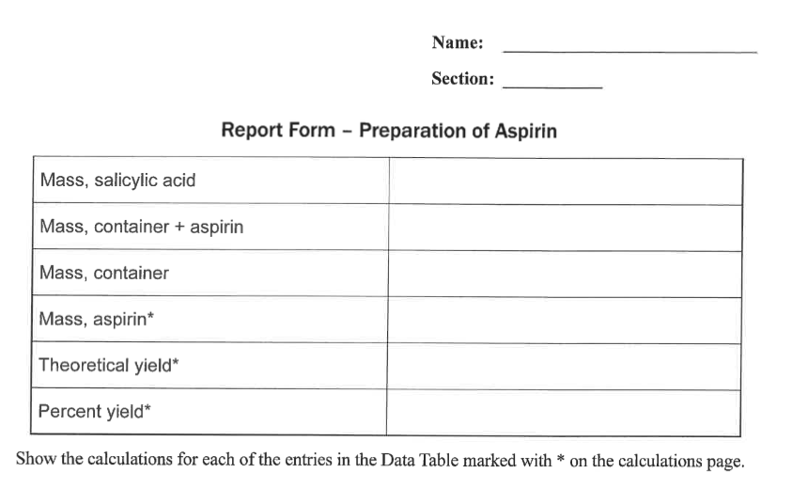
Chem 108
Synthesis of Aspirin
Due Today
Weigh Aspirin
Complete Part B
Calculate % Yield
Complete Report Form pp. 90-91 Provide labeled Calculation of % Yield & answers to questions pg. 91

Slide 3
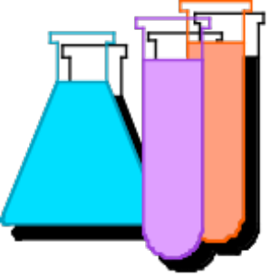
Percent Yield
In synthesis as in any experiment, it is very difficult and at most times impossible to be perfect. Therefore the actual yield (g) is measured and compared to the theoretical calculated yield (g). This is the percent yield:
% Yield = actual (g) / theoretical (g) x 100

Slide 4
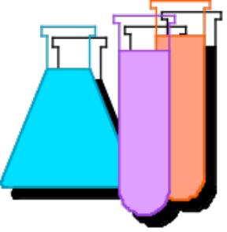
Theoretical (Yield) Mass Calculations
Reactant Product
grams (Reactant)
grams (Product)
Moles
Molar Mass
Stoichiometry
grams (R)
1 mol (R)
? mol (P)
grams (P)
? grams (P)
? mol (R)
grams (R)
1 mol (P)
(Divide)
Mass (R)
(Multiply)
Mass (P)
by Molar
"Gatekeepers”
from
Balanced reaction
by Molar

Slide 5
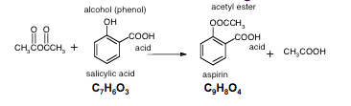
Theoretical Yield Example:
SA
A
grams (Salicylic Acid)
grams (Aspirin)
Moles
Molar Mass
C₉H₈O₄
MW = 180.15
Stoichiometry
grams (A)
(Molecular
6.00 grams (SA)
1 mol (SA)
1 mol A
Weight A)
? (A)
1 mol SA
grams (SA)
1 mol (A)
7.83 g
aspirin
(Molecular
Weight SA)
"Gatekeeper"
C₇H₆O₃
MW = 138.12

Slide 6
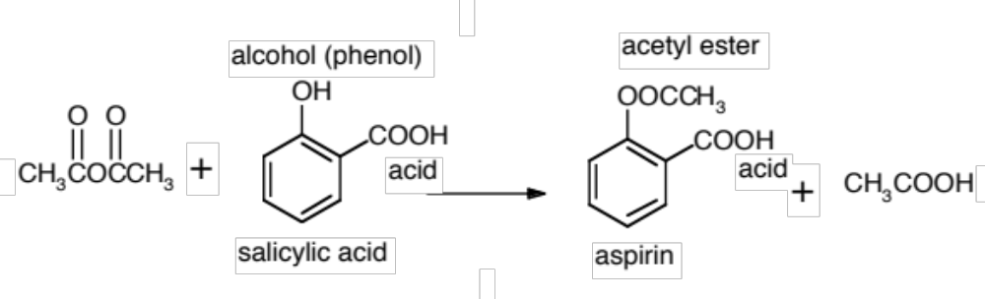
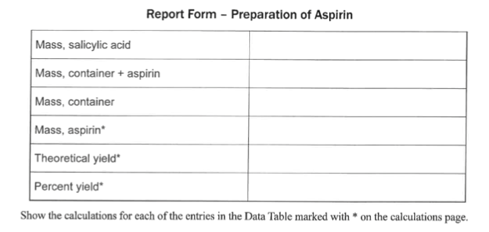
Percent Yield Example:
C₇H₆O₃
C₉H₈O₄
grams (Salicylic Acid)
7.83 g
grams (Aspirin)
Theoretical
6.00 g
% Yield = actual (g) / theoretical (g) x 100
84.60 g
77.69g
% Yield = (6.91g) /
(7.83 g) x 100
= 88.3%
6.91 g
7.83 g
88.3 %

Slide 7
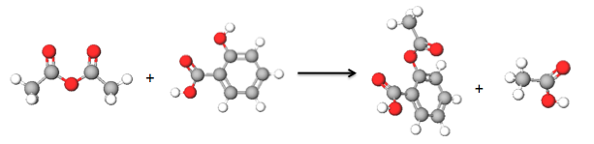
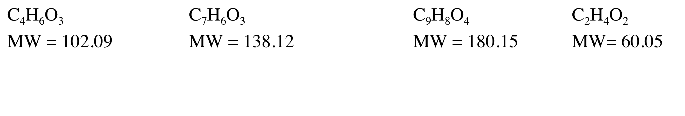
QUESTION
What is the % Yield of aspirin produced from 5.00 g of salicylic acid reacting with an excess of acetic anhydride, C₄H₆O₃ to yield 5.26g of aspirin?
Balanced Equation:

Slide 8
Answer (Part 1)
How many grams of aspirin can be theoretically produced from 5.00 g of salicylic acid reacting with an excess of acetic anhydride, C₄H₆O₃?
Balanced Equation:
A) 3.26 g B) 5.00 g C) 6.52 g D) 7.83 g

Slide 9
Answer (Part 2)
What is the percent yield based on the answer to Part 1, and actually obtaining 5.26 g?
Balanced Equation:
A) 65.2% B) 80.7% C) 100% D) 105.2%

Slide 10
Percent Yield
Calculate the % Yield:
actual yield (g) versus the theoretical calculated yield (g).
% Yield = actual (g) / theoretical (g) x 100
Weigh crude aspirin & calculate % yield.

Slide 11
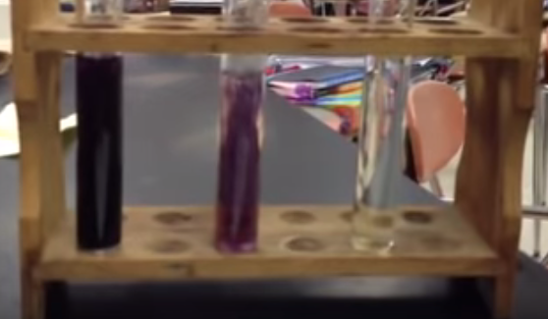
FeCl₃ & Starch Tests
Complete Part B; record your results.
Turn in individual Report Form pp.90-91 with partner’s name(s).

Slide 12
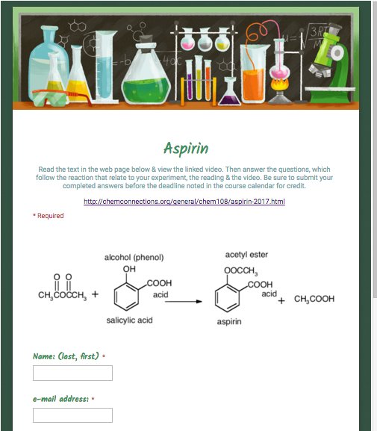
Post Lab Questions
Due on-line
http://chemconnections.org/general/chem108/Aspirin%20Guide.html

Slide 13
Check in lab drawer
Chem 108: Class/ Lab
(Return any loaned i-clickers)
Check that you have everything on the pink inventory sheet: clean & not broken; dispose of any broken glass in the broken glass container.
Replace the paper @ the bottom of the drawer with clean paper towel.
Note any missing equipment on the pink sheet., then replace all equipment in the drawer. Take a tag, write the combination number on the tag & fasten to lock.
Write your name on the blackboard. Dr. R. will check pink sheet & sign off.
Take the signed pink form and combination lock to the stockroom. . This completes your lab in Chem 108.
Thank you, and best wishes.

